Slide 1
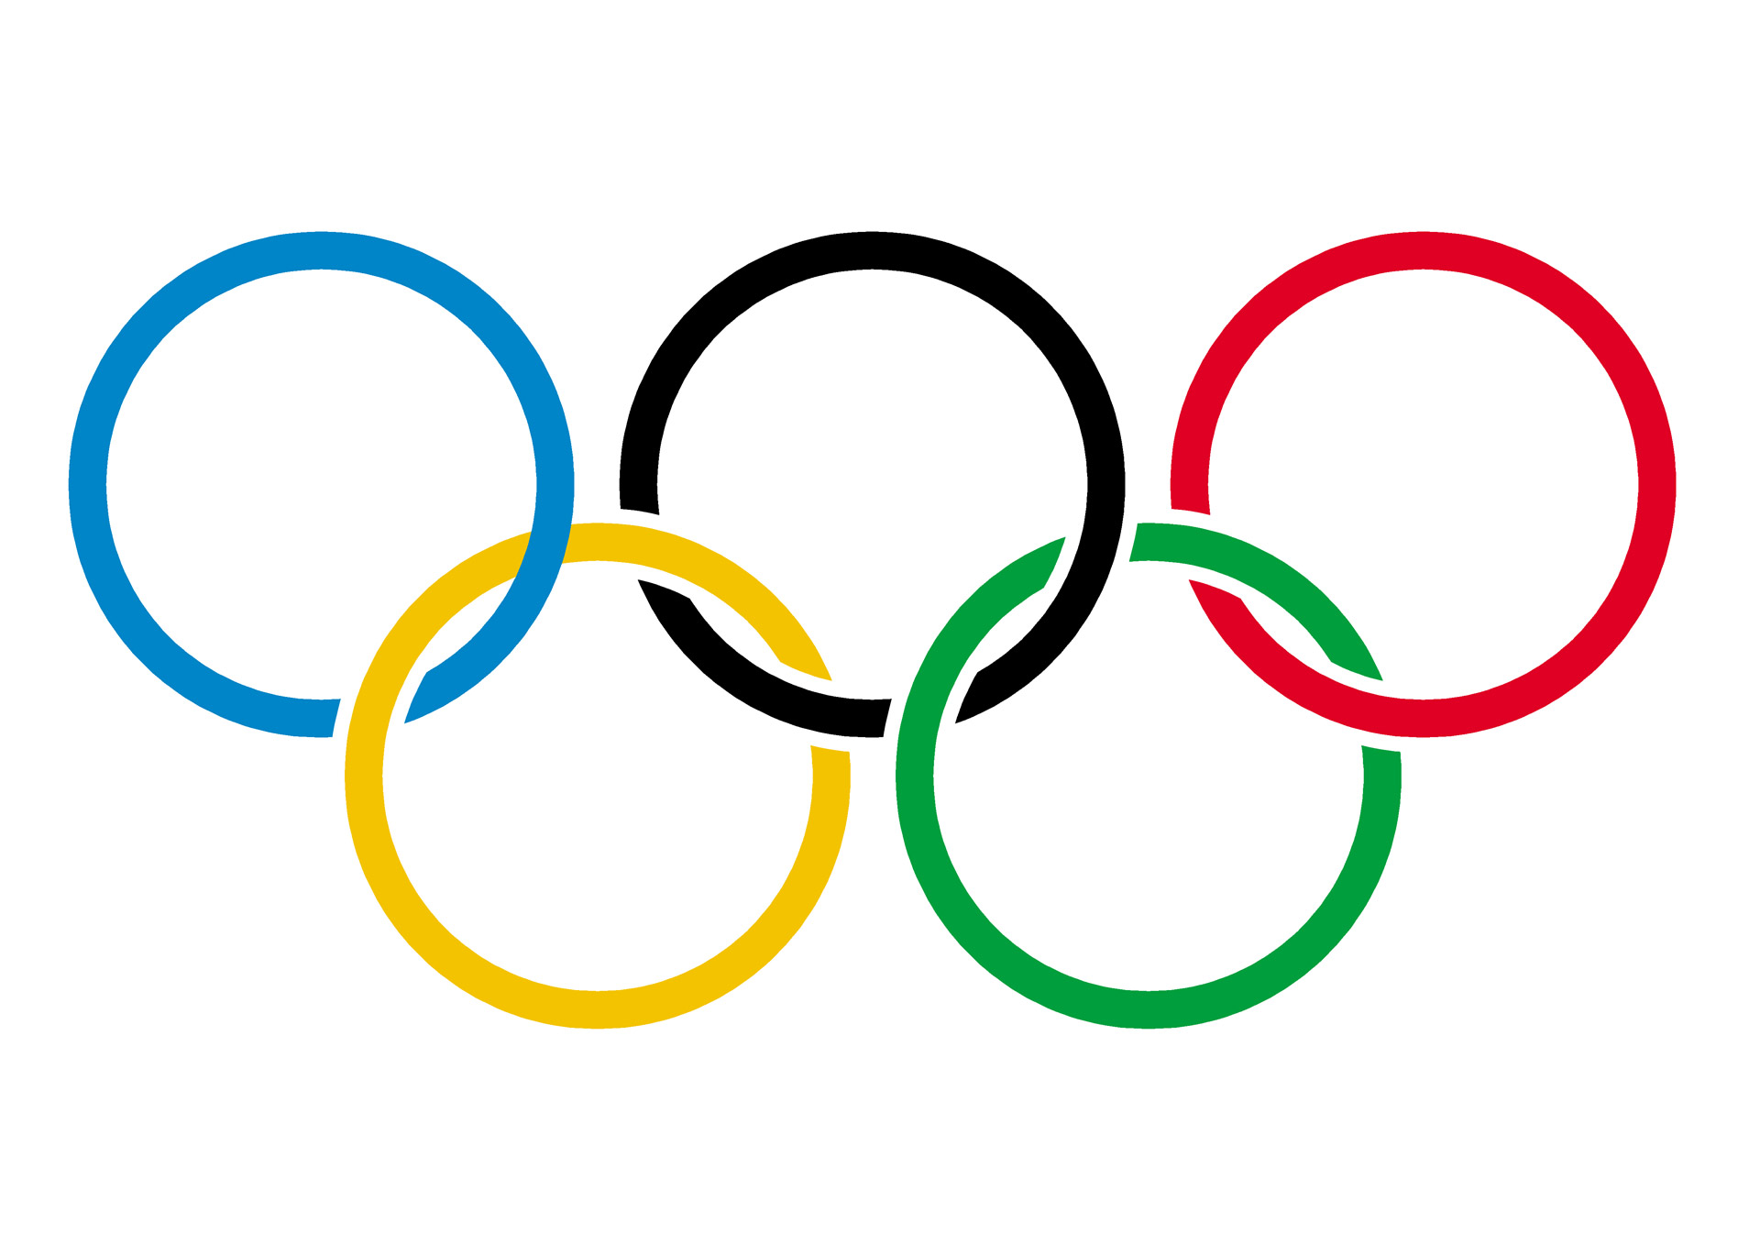
Olympics Insights
Analysis of 120 years of Olympic History Dataset
Sunidhi Gannamraju

Slide 2
Client’s Expectation
Client
Expectation
SportsStats is a sports analysis firm partnering with local news and elite personal trainers to provide “interesting” insights to help their partners.
Client wants to provide patterns/trends highlighting certain groups/events/countries, etc. for the purpose of developing a news story or discovering key health insights.

Slide 3
Questions to Answer
Top 5 Olympic Dominant nations over a sustained period
Olympic Legends for each game who sustained success over several Olympic cycles.
Maximum participation and medals won among Males and Females in India
Trend in Anthropometric measures of top performing athletes for each sport
Client

Slide 4
Initial Hypothesis
India’s participation in the recent years might have improved
Olympic legends might have achieved >5 medals in their lifetime
Top performing athletes might belong to the Developed countries.
Women’s participation would have increased in past 60 years
All the regions mentioned in the `Athelets_events` table should match with the `Noc_regions` tables
For all the Games happened, dataset will provide information on gold, silver, and bronze medallists.

Slide 5
Initial Findings
Number of countries participated till 2016 is 207
Identified list of Gold medalist for each sport in each year
India’s participation has drastically increased since it’s independence i.e., from the year 1947
Average BMI index lies between 20 to 25 for each sport as shown in the Scatter plot graph whereas Box Plot provides median for each sport

Slide 6
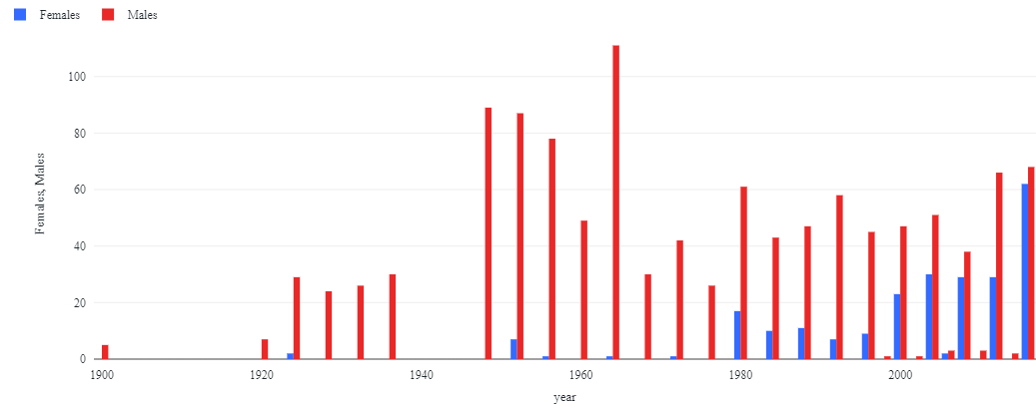
Initial Findings Participation Trend based on Gender
Client

Slide 7
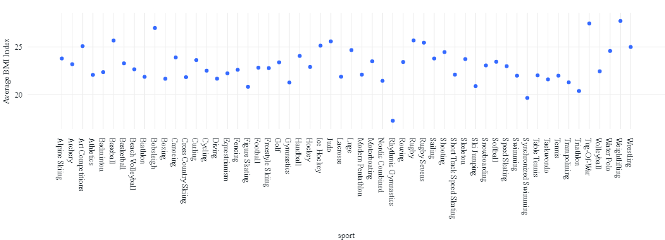
Initial Findings Average BMI Index of players for each sport
Client

Slide 8
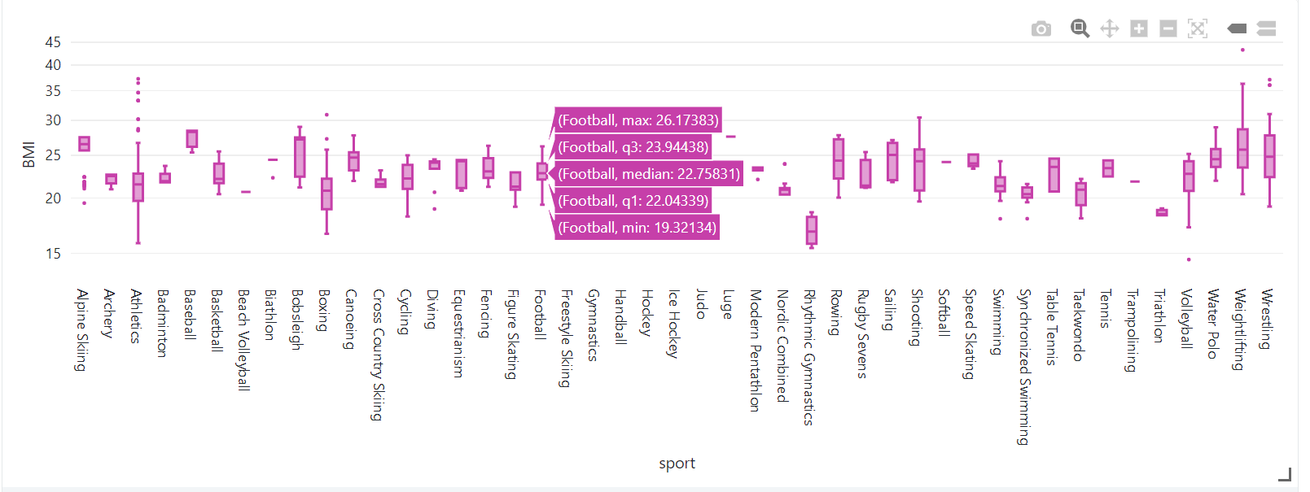
Initial Findings Average BMI Index of players for each sport
Client

Slide 9
Deeper Analysis Olympic Dominant Nations
The top consistent performing countries across a variety of sports are referred to as "Olympic powerhouses" or "dominant Olympic nations".
Top 5 Dominant nations are USA, Germany, Russia, Canada, UK
The above 5 nations are largest economies in the world.

Slide 10
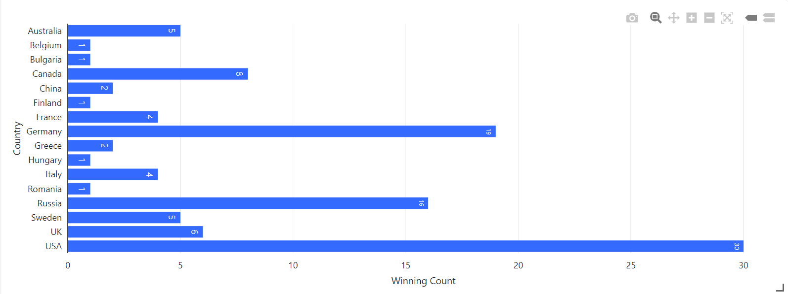
Deeper Analysis Olympic Dominant Nations

Slide 11
Deeper Analysis Olympic Legends
The Olympic Legends are the consistent performers in each game in Olympics can achieving high rankings or medals in multiple Olympic games.
Players with more than 5 medals are shortlisted as Olympic Legends in the below shown table

Slide 12
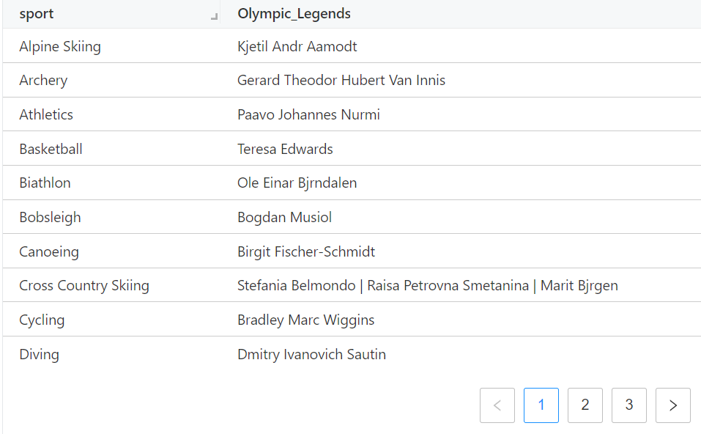
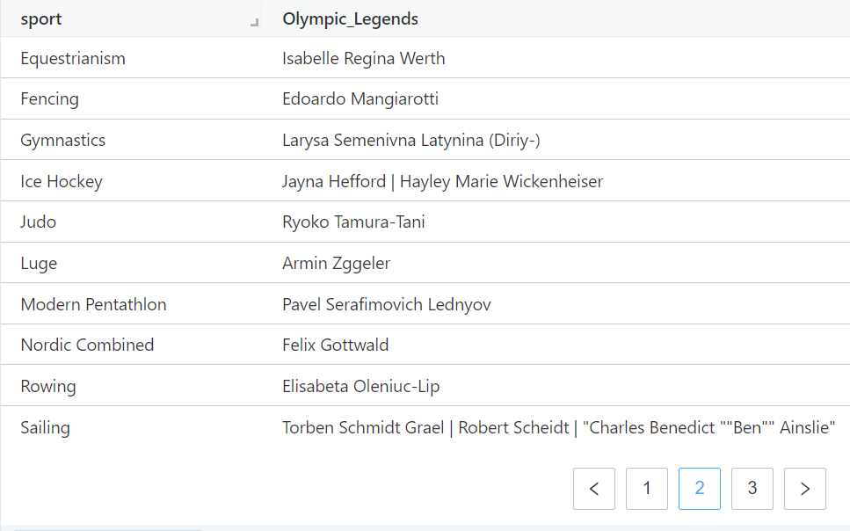
Deeper Analysis Olympic Legends

Slide 13
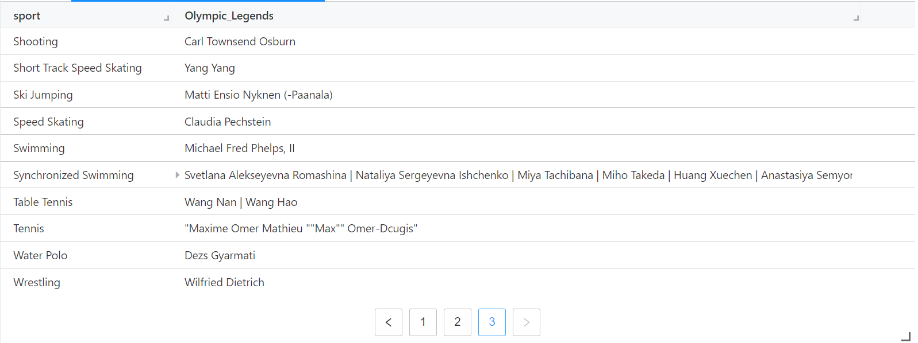
Deeper Analysis Olympic Legends

Slide 14
Deeper Analysis India’s participation v/s Medals won
Females:
Females need support and resources to participate and compete at highest levels.
Maximum participation was seen in games like Athletics (90), Hockey (30), Shooting (26), Archery (24) and Badminton (13)
Maximum medals won in Badminton (2), Boxing(1), Weightlifting(1) and Wrestling(1)
Males:
Hockey (315), Athletics (179), Wrestling (100), Gymnastics (83), Shooting (79)
Maximum medals won in Hockey (173), Alpinism (7), Shooting (4), Wrestling (4), Athletics (2), Boxing (1)

Slide 15
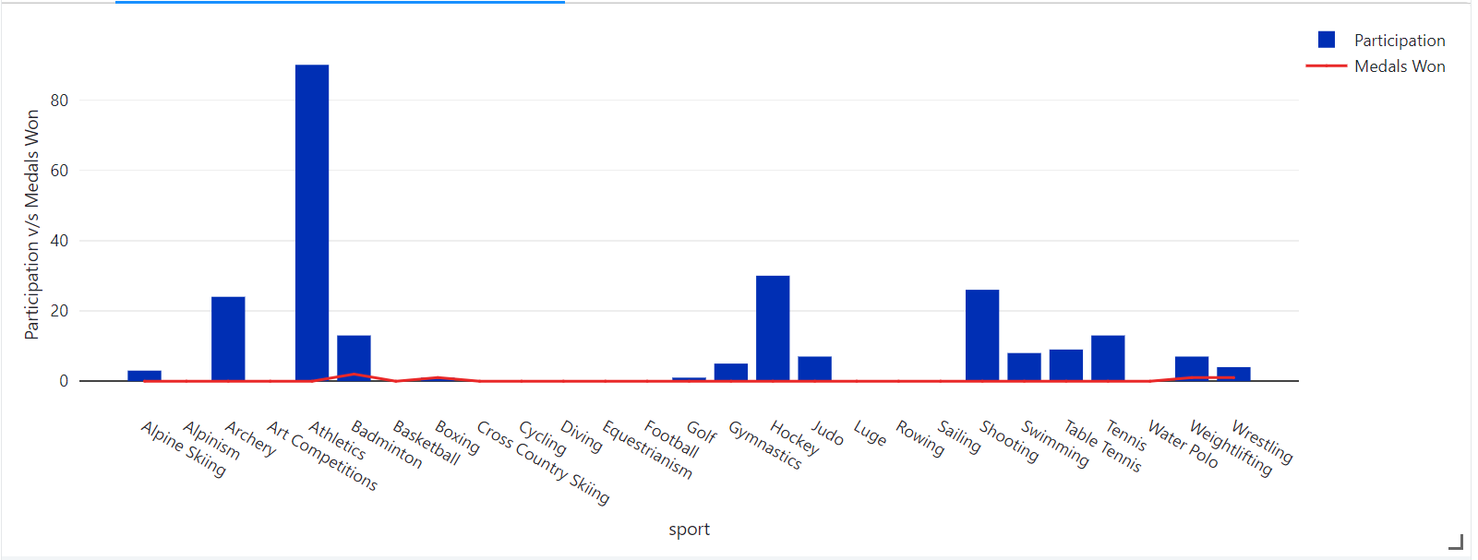
Deeper Analysis India’s participation v/s Medals won by Females

Slide 16
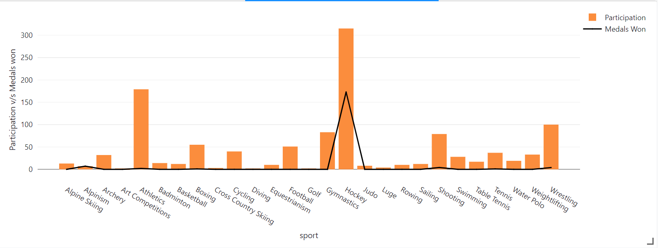
Deeper Analysis India’s participation v/s Medals won by Males

Slide 17
Deeper Analysis Average Anthropometric measures of top athletes
Average BMI of Winners for each sport lies in the range of 20 to 25.
In almost all games, average BMI index of women winners is less than Men’s BMI in each sport
Average age of winners lie between 25 to 30 for all games with negligible difference between Males and Females

Slide 18
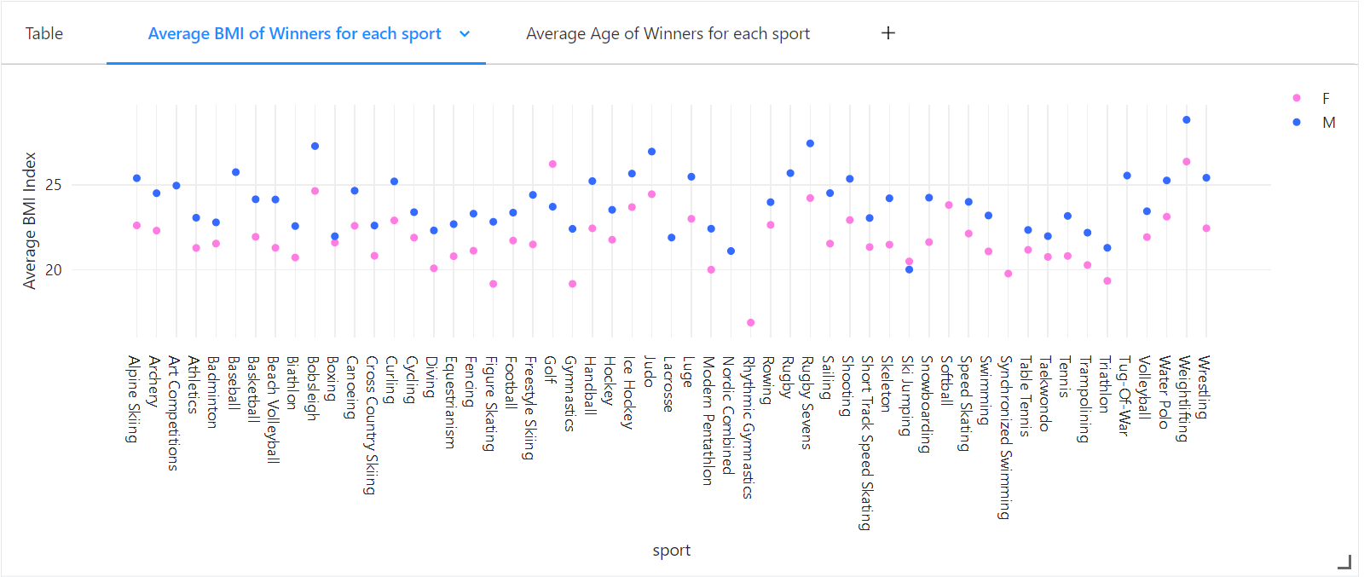
Deeper Analysis Average Anthropometric measures of top athletes

Slide 19
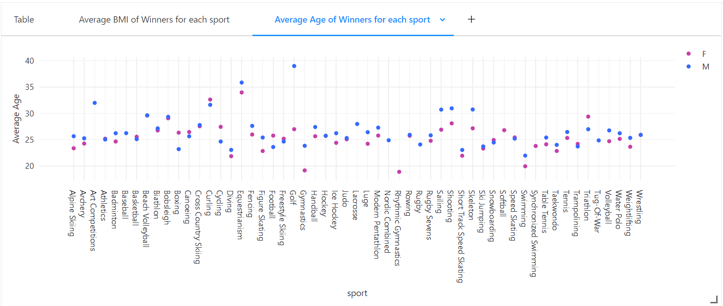
Deeper Analysis Average Anthropometric measures of top athletes

Slide 20
Final Findings
Identified Olympic Dominant nations clearly indicate that they have surely spent more on “Player Transfer fees” to improve player’s overall performance
These Legends are important in celebrating the history and significance of the Olympic Games and inspiring future generations of athletes to strive for greatness.
Female participation has to be increased in India along more focus on training them to win maximum medals

Slide 21
Project Link: Olympic Dataset Analysis on Databricks Platform

